Slide 1


Combining observations with data
We will discuss the basics of:
Generating a composite model SED
Generating an observed SED
Photometric redshifts
SFH parametrisation
Different fitting techniques (exercise)
Themiya Nanayakkara
@themiyan

Slide 2
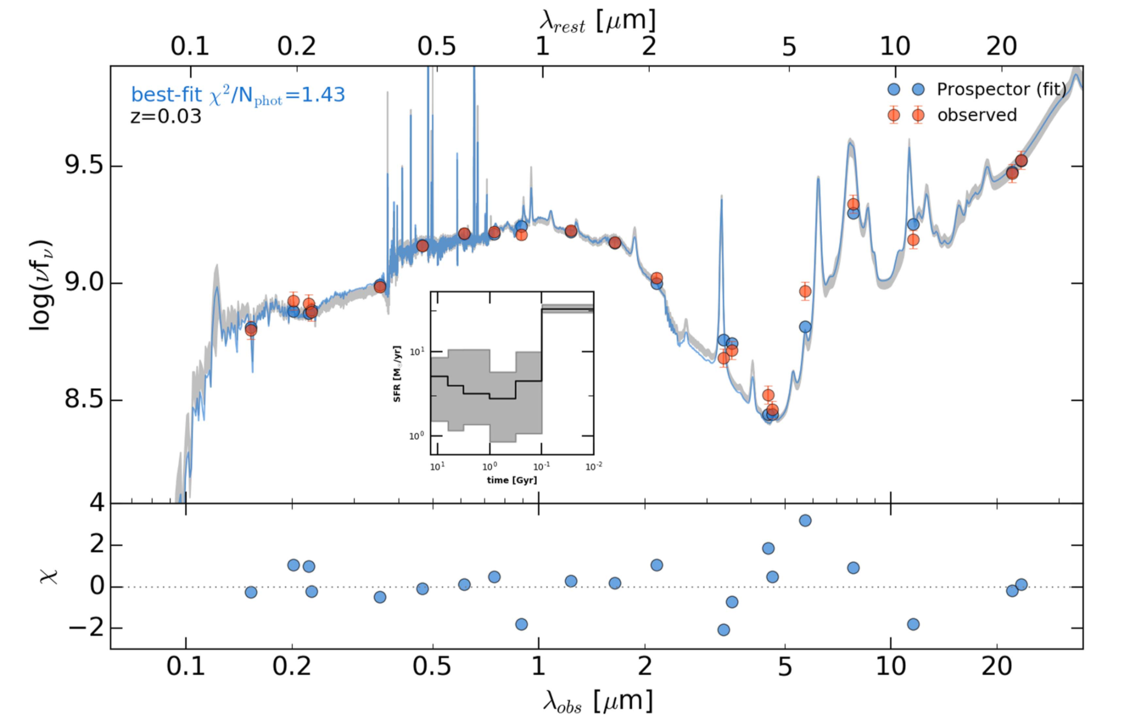
What is SED fitting?
The attempt to analyse a galaxy SED and derive one or several physical properties simultaneously from fitting models to the observed SED.

Slide 3
Why fit SEDs?
Different physical processes occurring in galaxies all leave their imprint on the global and detailed shape of the spectrum, each dominating at different wavelengths.
So detailed analysis of the shape of an observed SED can be used to fully infer details about galaxies.

Slide 4
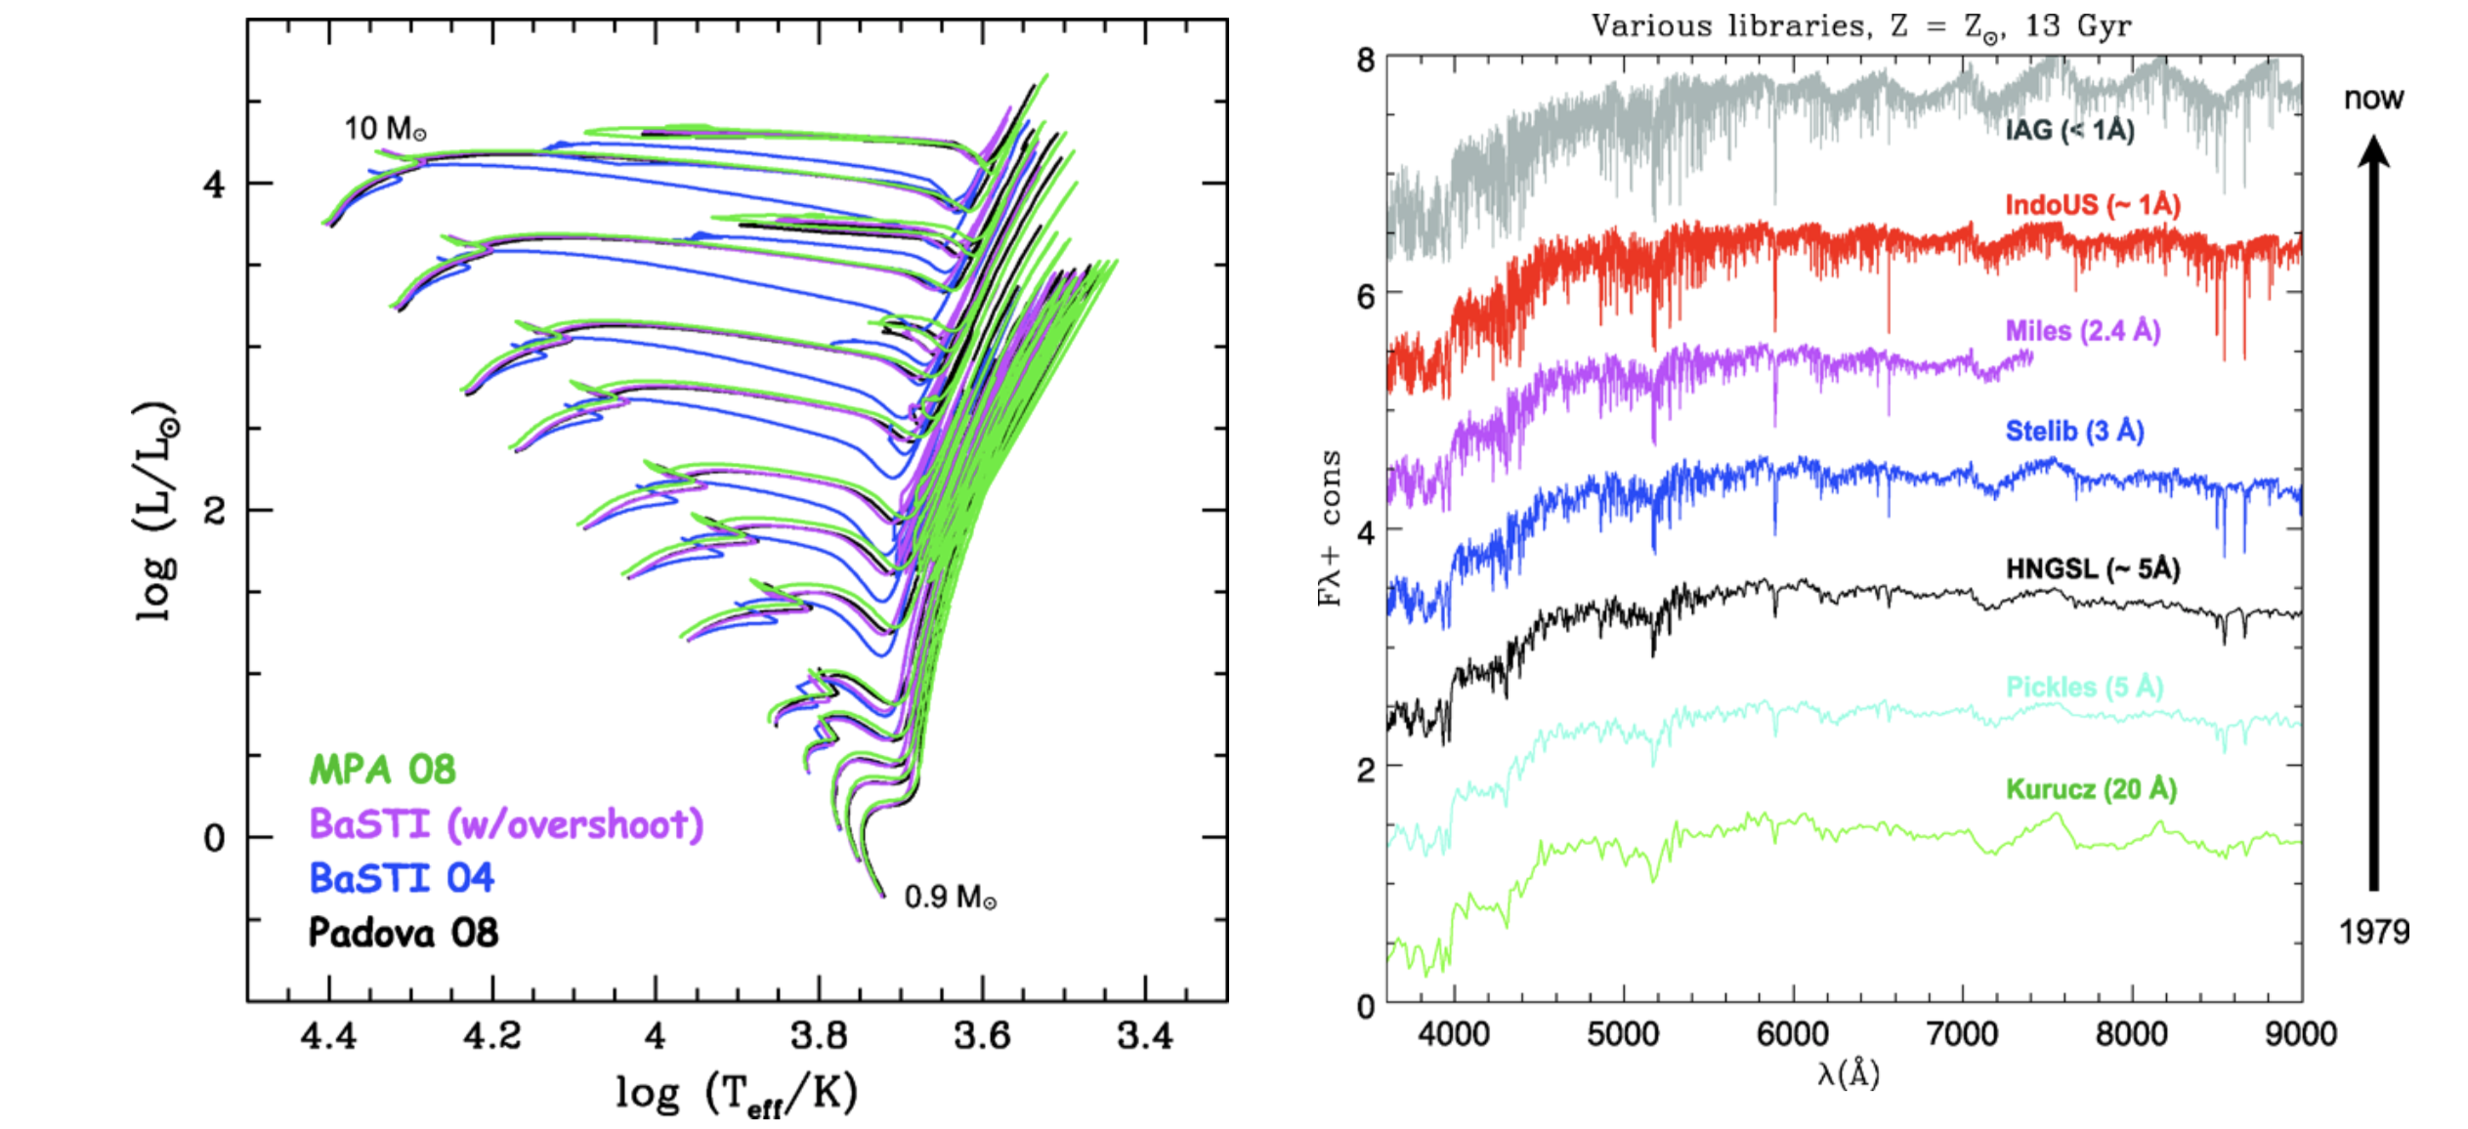
Generating composite SEDs
First a set of composite SEDs are required, generally produced using SSPs using theoretical or observed stellar libraries.

Slide 5
Other parameters required
ISM gas: atomic form crucial to reprocess λ<912A photons into strong UV, optical, IR emission lines.
General assumption in photoionisation is that all such photons are absorbed within the Strömgren sphere and is re-emitted in the hydrogen recombination lines.
ISM dust: attenuates shorter wavelengths and re-emits absorbed energy at higher wavelengths.
Some codes are now able to combine the stellar and dust emission together. e.g., FSPS, MAGPHYS
However, large uncertainties may be present over on how how dust attenuation, dust-to-metal ratios, re-radiation, and differential emission from birth-cloud and diffuse dust components.

Slide 6
Simplified galaxy evolution
Three main things to consider when making purely theoretical SEDs:
Chemical evolution: metallicity, infall rates, and dust pollution rates are used to workout the ISM properties, which are then combined with the SSPs.
Models involving the whole galaxy: based on hydrodynamic and N-body codes and considers star formation from gas and feedback processes.
Cosmological models: use outputs from DM simulations to approximate galaxy formation within dark matter haloes (e.g. gas cooling, star formation, AGN fuelling, feedback) to consider effects of mergers, gas content and metallicity to determine the spectra of the galaxy.

Slide 7
Observed galaxy SEDs
Part from theoretical models, observations made on singular galaxies in a large wavelength range can be used to produce an observed galaxy SED.
Things to keep note:
Spectral response curve and resolution
Spatial resolution, aperture bias, and matching.

Slide 8
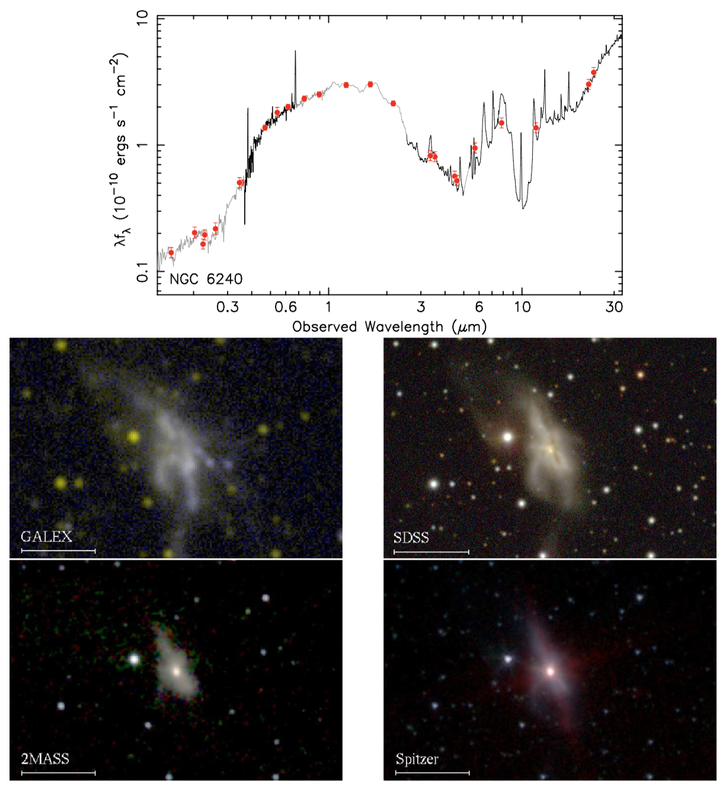
Observed galaxy SEDs

Slide 9
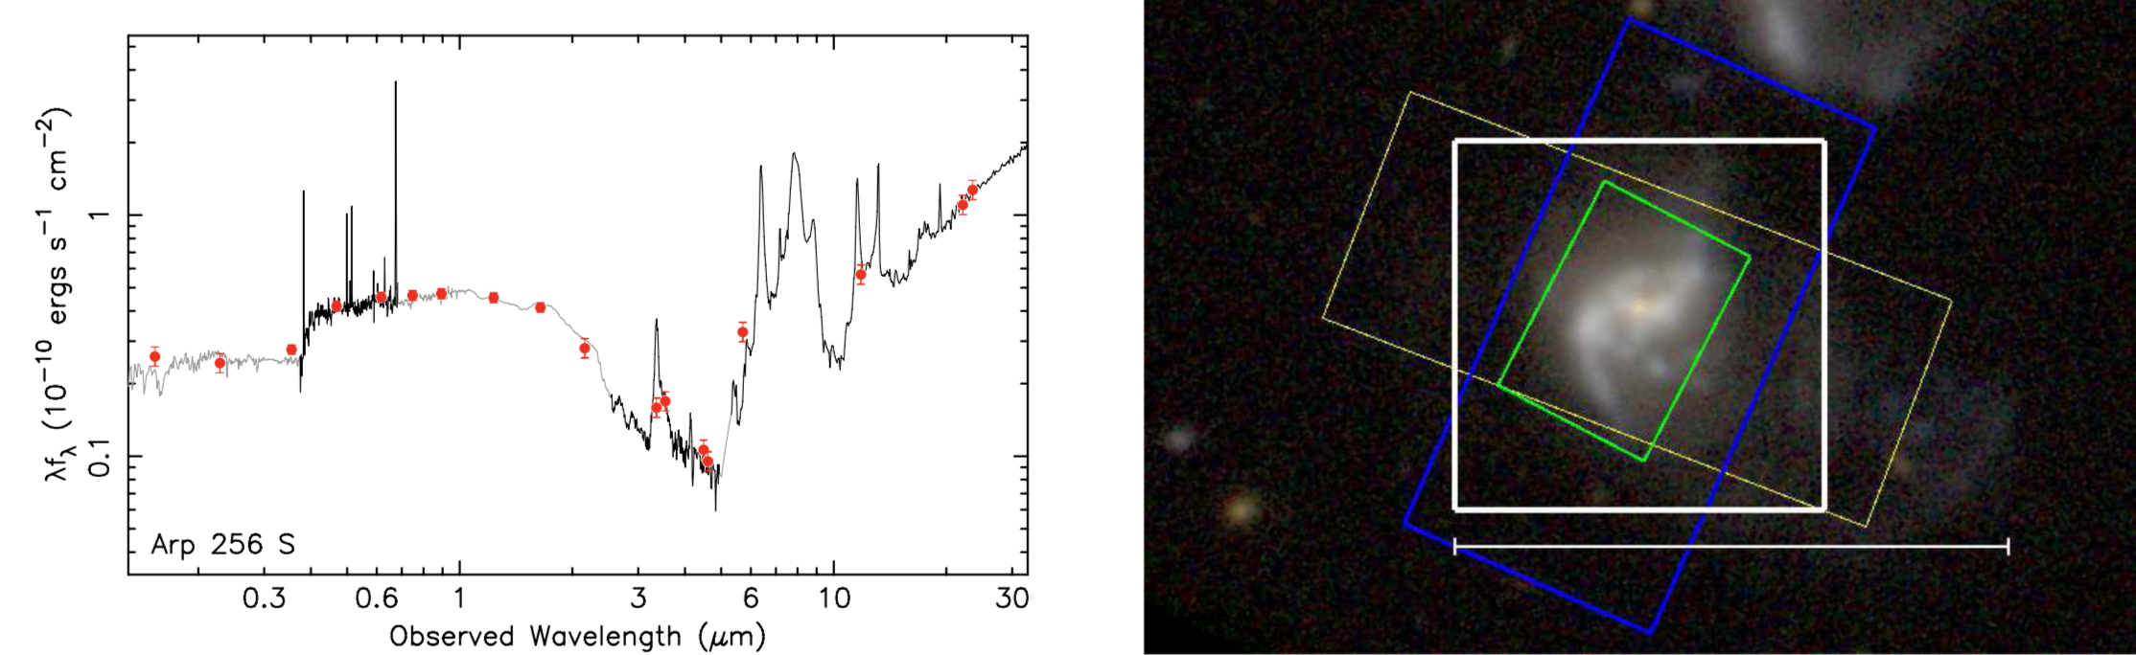
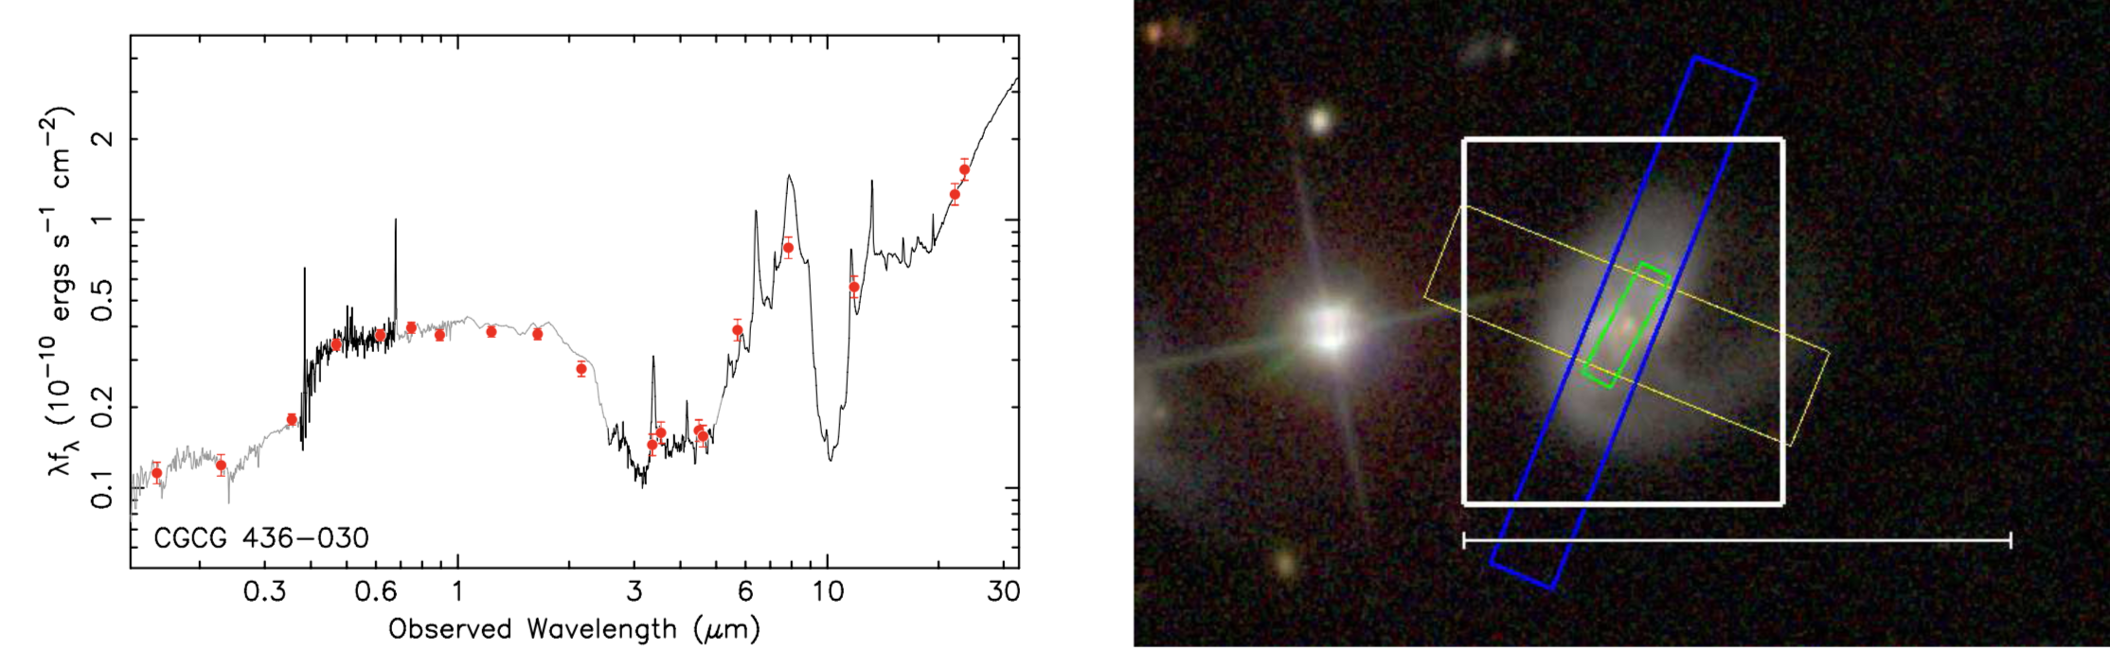
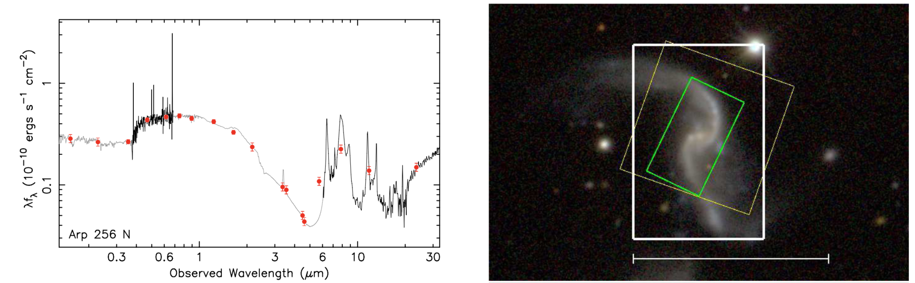
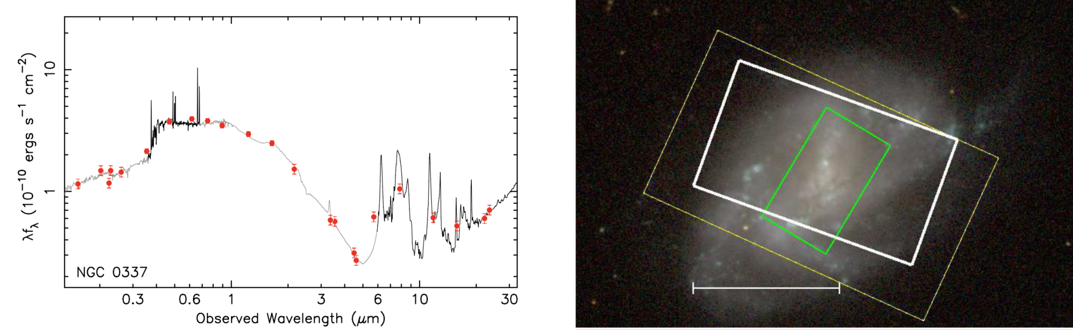
Observed galaxy SEDs

Slide 10
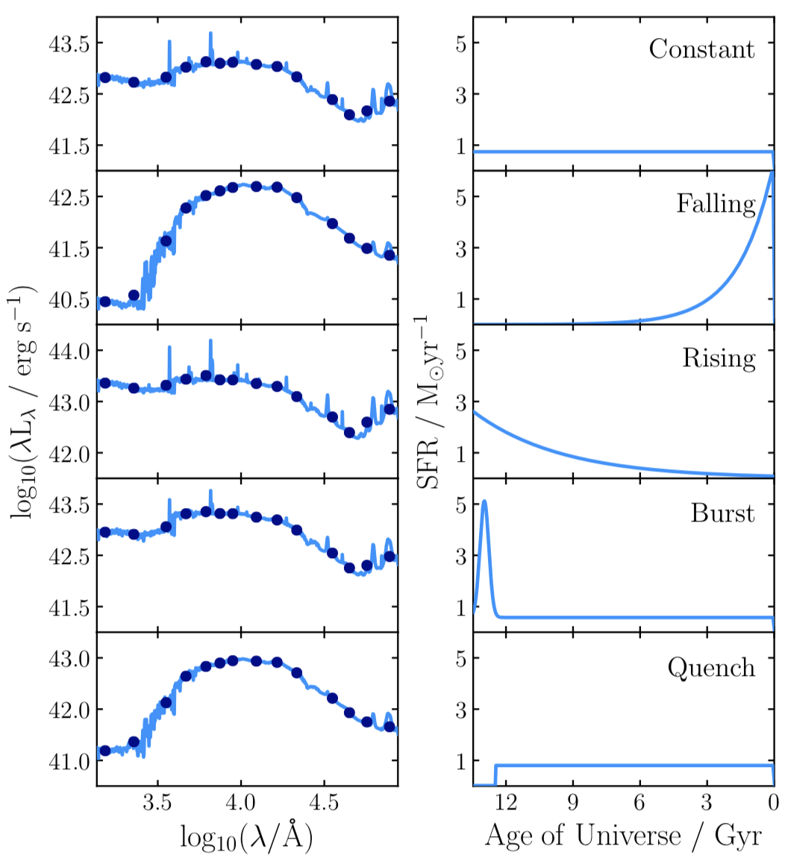
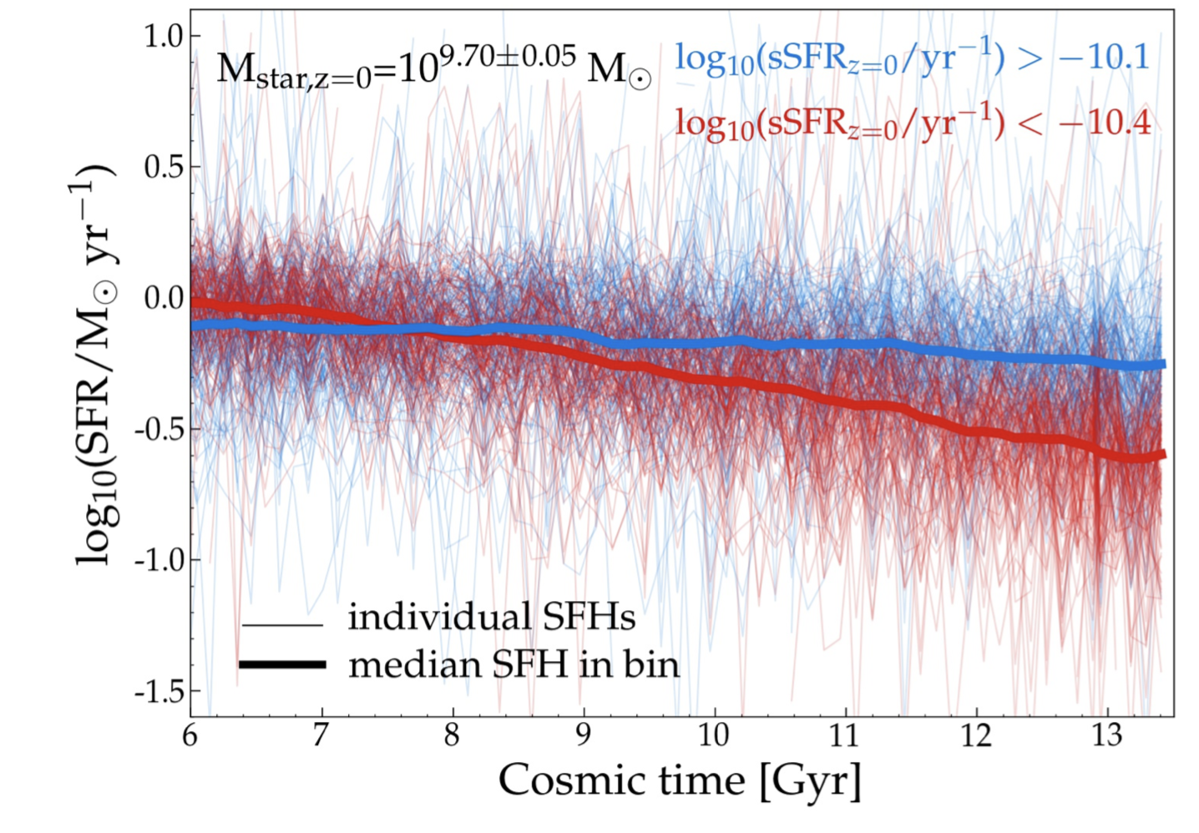
SFH parameterisations
Can be parametrised using parametric or non-parametric models
Non-parametric models may look closer to `real` SFH but hard to constrain due to the increased number of free parameters

Slide 11
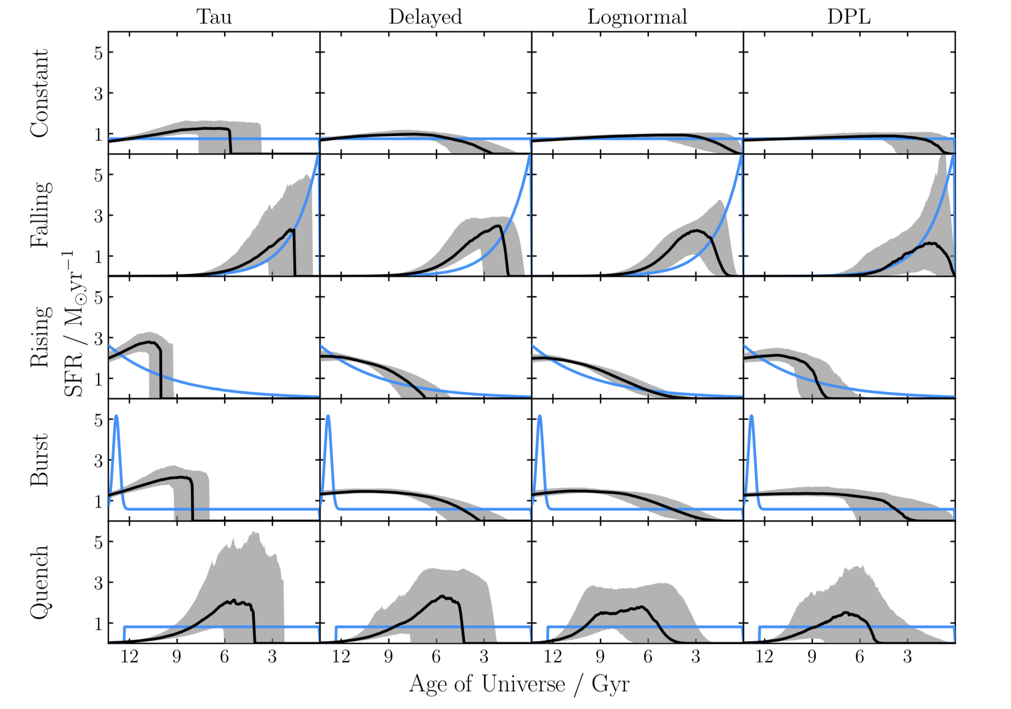
SFH parameterisations
It is not easy to reproduce the input SFH parametrisation

Slide 12
Fitting techniques used by different fitting techniques
Spectral indices
PCA
Spectral fitting by inversion
Bayesian
Read Section 4 in Walcher et al,. 2011 https://ui.adsabs.harvard.edu/#abs/2011Ap&SS.331....1W/abstract

Slide 13
Typically inferred properties
Photometric redshifts
Stellar mass
SFR and SFH
Dust extinction
Metallicity
Age
Note: Derived properties may suffer from strong degeneracies, therefore need to take values with a grain of salt.

Slide 14

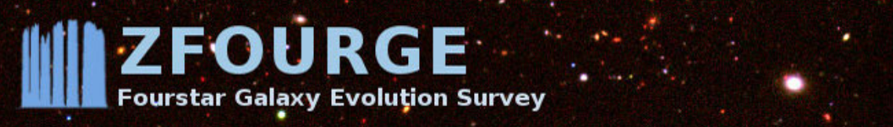
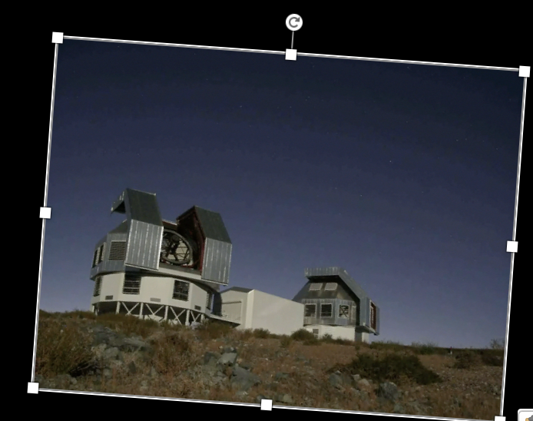
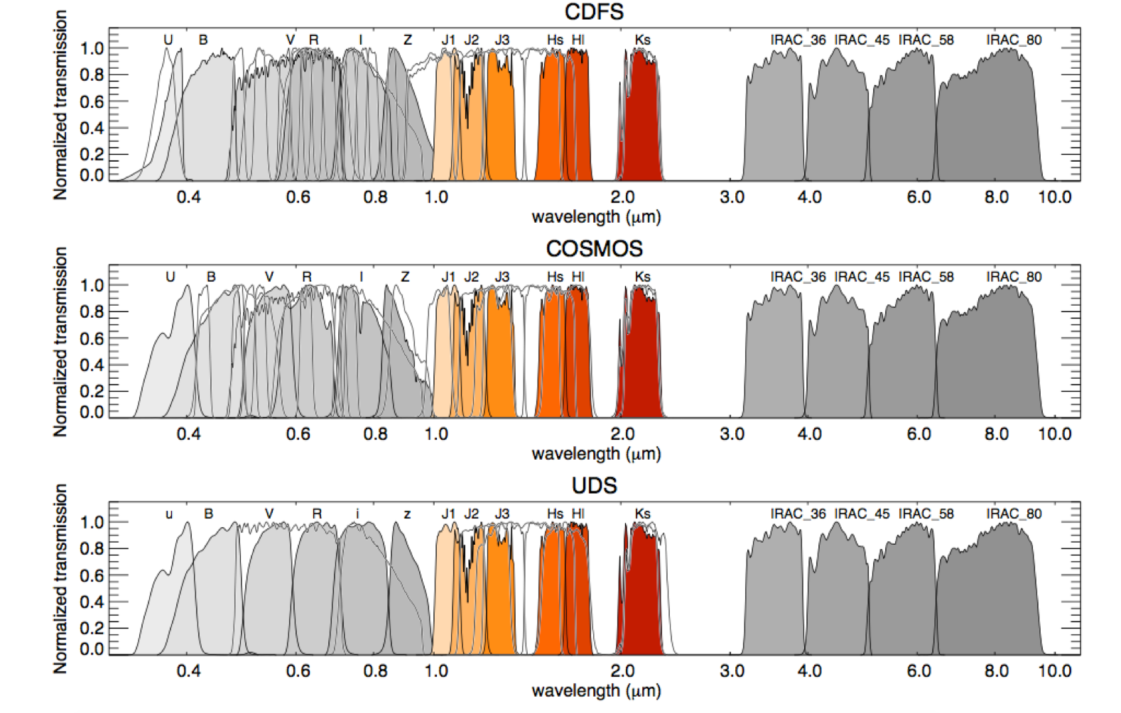


Multi-wavelength survey of the universe
Uses narrow band imaging to constrain photometric redshifts
45 nights on Magellan: FourStar
3 HST legacy fields: COSMOS, CDFS and UDS of 11’ X 11’ FOV

Slide 15
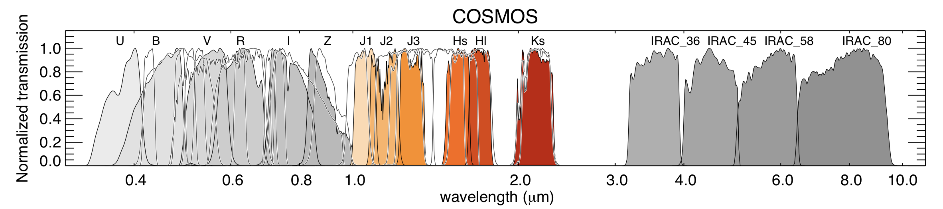
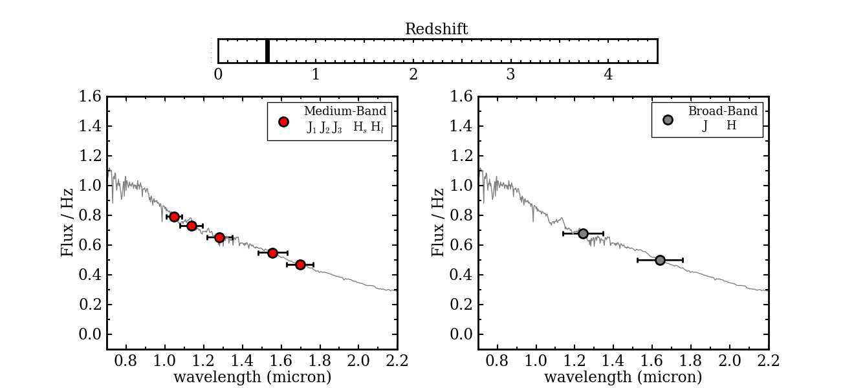
Photometric redshifts

Slide 16

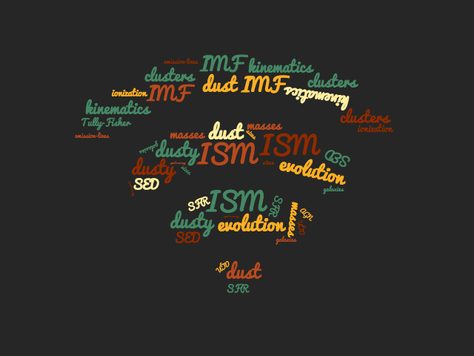
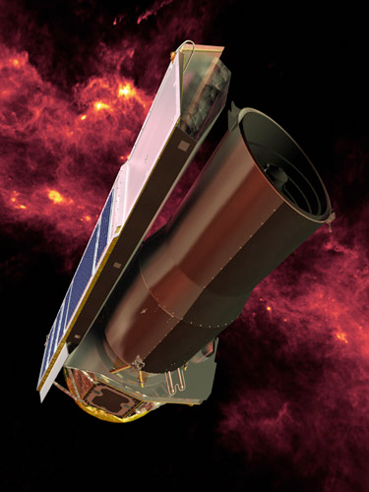

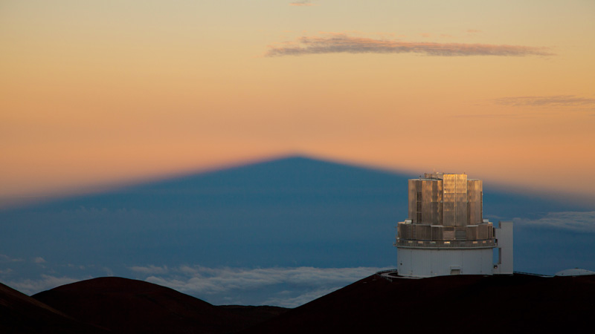

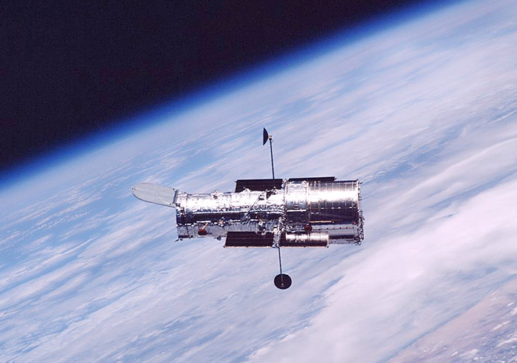

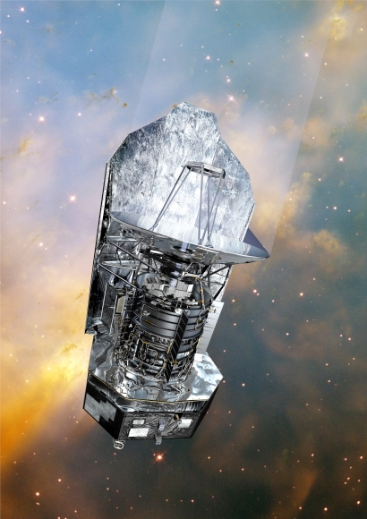

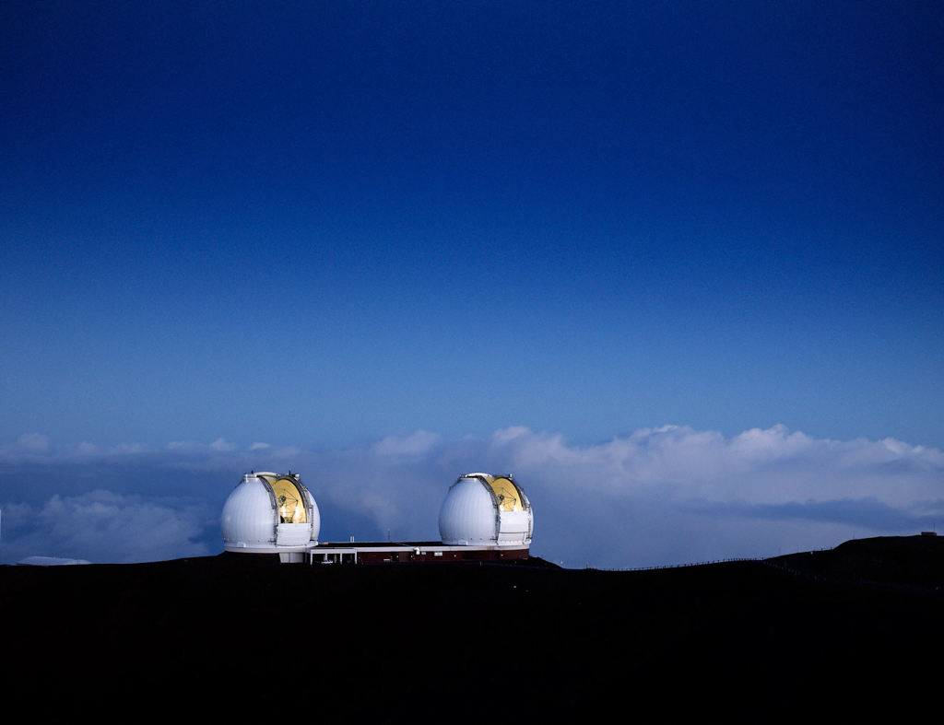

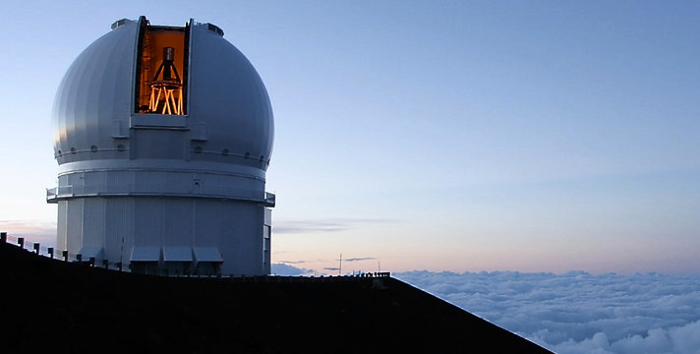
Today you’ll be using data from the ZFOURGE data to fit observed photometry to SED models to infer properties of galaxies using a code called FAST
Subaru
Combination of deep observations
Spitzer
Magellan
Hubble
Keck
CFHT
Herschel

Slide 17
